Slide 1

DEPARTMENT OF INFORMATION TECHNOLOGY UNIVERSITY COLLEGE OF ENGINEERING SCIENCE AND TECHNOLOGY HYDERABAD
JAWAHARLAL NEHRU TECHNOLOGY UNIVERSITY HYDERABAD
A
MINI PROJECT
ON
Prediction of Heart Disease Using MACHINE LEARNING Algorithms
Presented by:
R.Venu
24011D2515
M.Tech(SE)

Slide 2
ABSTRACT
Data mining is widely used to process healthcare data.
Cardiovascular diseases are the leading cause of death globally.
Early identification of heart disease risk factors is essential for prevention and treatment.
Medical parameters such as cholesterol, blood pressure, and age are used for
classification.
Algorithms used: Decision Tree ,KNN and SVM
SVM algorithm shows the highest precision in predicting heart disease risk.

Slide 3
INTRODUCTION
Prediction of Heart Disease Using Machine Learning Algorithms applies data mining methods to identify individuals at risk of heart disease based on historical health data.
As cardiovascular disorders remain among the top causes of mortality
Widely used in healthcare to analyze digital medical records and diagnostics..
Algorithms used: Decision Tree , KNN and SVM (implemented in Python).
Parameters analyzed: Age, sex, blood pressure, cholesterol, ECG, etc.
Data preprocessing includes handling missing values, normalization, and feature selection.
SVM model outperforms in precision and interpretability.

Slide 4
LITERATURE SURVEY
S.NO. | AUTHOR | DESCRIPTION | YEAR
1 | R. N. Desai | Applied Decision Tree and Naive Bayes for heart disease prediction. | 2020
2 | Verma and Yadav | Compared ML algorithms on UCI dataset for predicting cardiovascular risk. | 2021
3 | H. B. Pate. | Used SVM and KNN models for clinical heart data classification. | 2022
4 | Kumar and Reddy | Developed a Streamlit-based app for heart disease detection using Python. | 2023

Slide 5
EXISTING WORK
ADVANTAGES
DISADVANTAGES
Uses standard tools like WEKA with algorithms (Naive Bayes, Decision Trees, Neural Networks). | Relies on manual interpretation, increasing chances of human error.
Capable of processing clinical features like age, BP, cholesterol, ECG, etc. | Limited ability to detect early-stage heart disease accurately.
Offers basic prediction accuracy in identifying heart-related conditions. | Models are static, with no ability to learn from new medical data
Easy to implement and understand using predefined models. | Lacks interactive interfaces for doctors or patients.
 | Does not provide visual explanations or intuitive decision paths for practitioners.

Slide 6
PROPOSED WORK
Implements multiple machine learning models:
K-Nearest Neighbors (KNN)
Decision Tree
Support Vector Machine (SVM)
Performs data preprocessing steps (Handling missing valuesNormalization)
Encoding categorical features (e.g., chest pain type, ECG results)
Inputs include medical parameters such as age, sex, BP, cholesterol, ECG results, etc.
Models are trained and evaluated using metrics like accuracy and precision.
Outputs prediction results with visual insights to assist healthcare professionals.
Provides an interactive user interface via Streamlit for easy data entry and result visualization.

Slide 7
PROPOSED WORK MODULES
Data Preprocessing Module
Feature Selection Module
Evaluation Module
Prediction Module
User Interface Module (Streamlit)

Slide 8
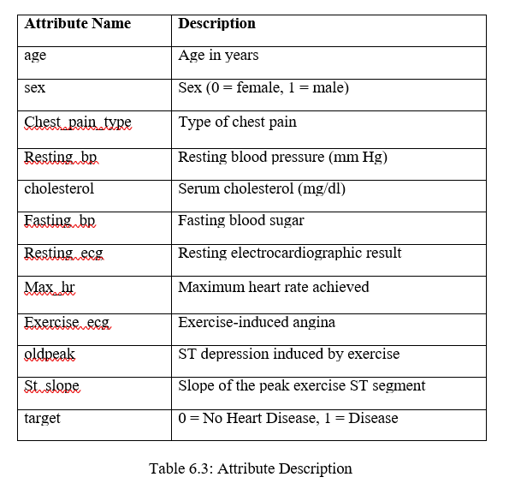
DATASET DESCRIPTION
The heart_disease_dataset.csv dataset, sourced from Kaggle.com, contains 12 attributes and a label indicating the prediction is negative (0) or positive (1). The dataset initially comprised 2515 observations, which were reduced to 1314 after removing null values. Among these, 80% of the dataset represents for training, while the remaining 20% represents testing.

Slide 9
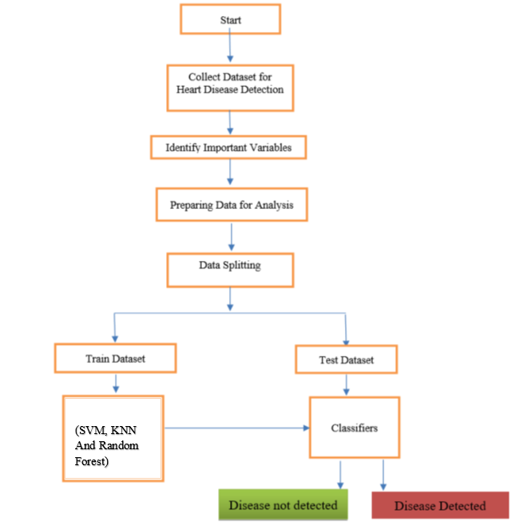




PROPOSED ARCHITECTURE
Start the prediction process.
Collect heart disease dataset with clinical features
Select importantvariables(age,BP, cholesterol, etc)
Preprocess data (cleaning, normalization, encoding).
Split data into training and testing sets.
Train models: SVM, KNN, and Random Forest.
Test classifiers on test data.
Decision
Tree
Fig proposed architecture

Slide 10
PROPOSED ALGORITHMS
ALGORITHMS:
Decision Tree Algorithm
Support Vector Machine (SVM) Algorithm
K-Nearest Neighbors (KNN) Algorithm
Evaluation Metrics:
Accuracy
Precision
Recall
F1 Score

Slide 11
EXPERIMENTAL RESULTS & ANALYSIS
All models (Random Forest, SVM, KNN) we are trained on the same preprocessed heart disease dataset.
S.NO | Model | SVM | KNN | Decision Tree
1 | Accuracy | 0.98 | 0.97 | 0.95
2 | Precision | 0.97 | 0.96 | 0.94
3 | Recall | 0.99 | 0.98 | 0.96
4 | F1-Score | 0.98 | 0.97 | 0.95

Slide 12
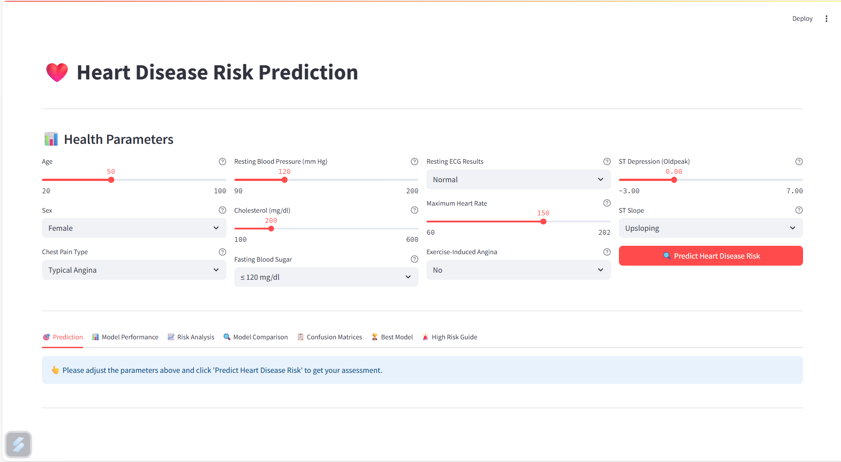
Fig home page(Heart disease prediction)

Slide 13
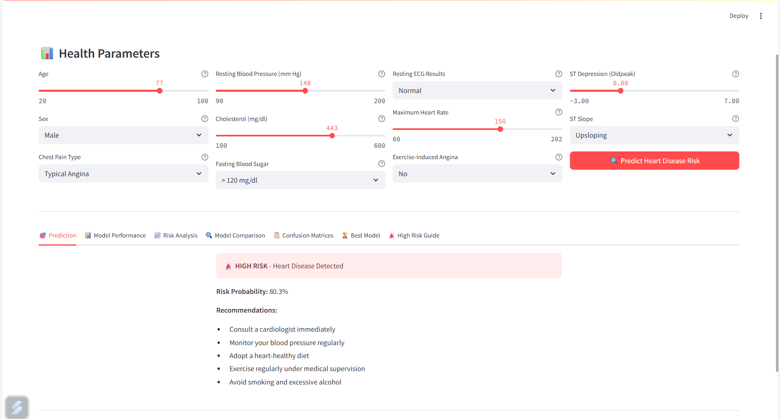
Fig predicted output
This is a Streamlit-based Heart Disease Prediction app where users input health data and get an instant risk prediction and Recommendations

Slide 14
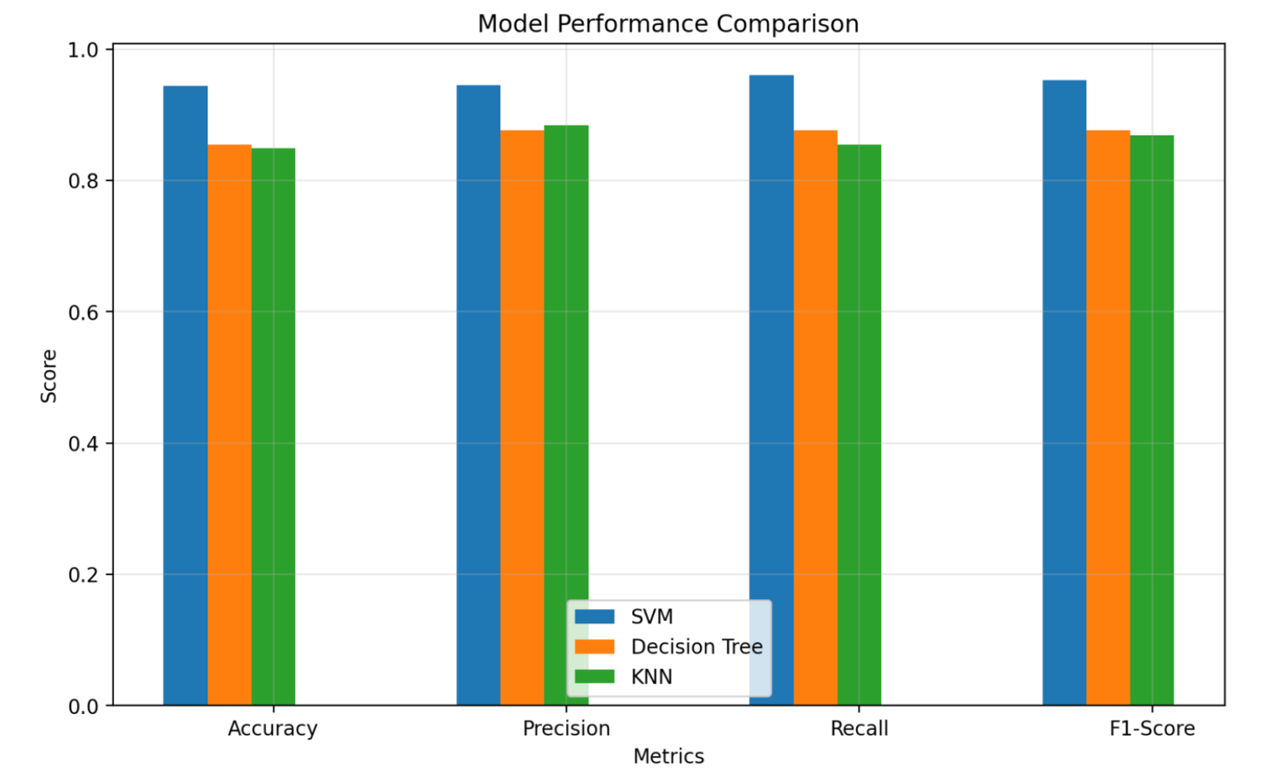
Fig SVM vs KNN vs Decision Tree
SVM shows the highest values in Accuracy, Precision, Recall, and F1-Score, proving to be the best performing model for heart disease prediction.

Slide 15
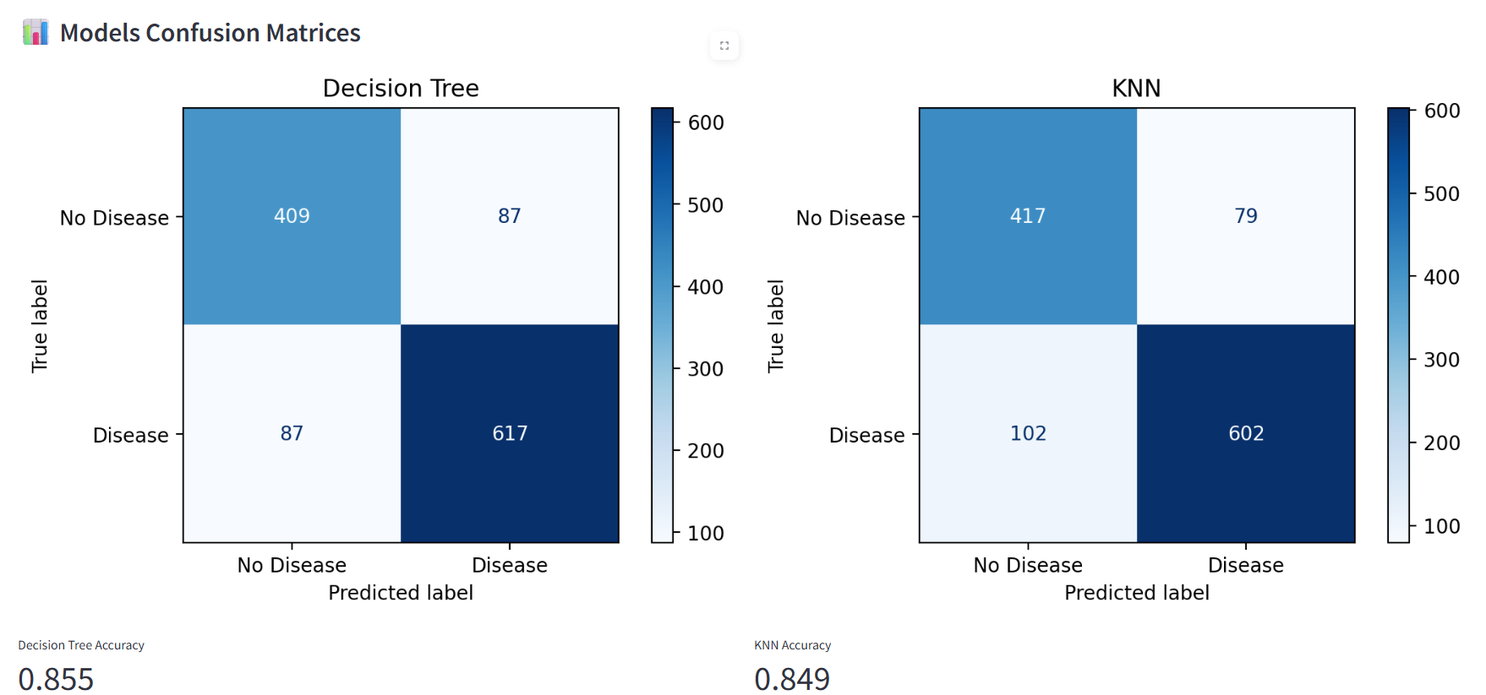
Fig Confusion Matrix of Decision Tree and KNN
The image compares the performance of two machine learning models — Decision Tree and K-Nearest Neighbors (KNN) — for heart disease prediction using confusion matrices and accuracy scores.

Slide 16
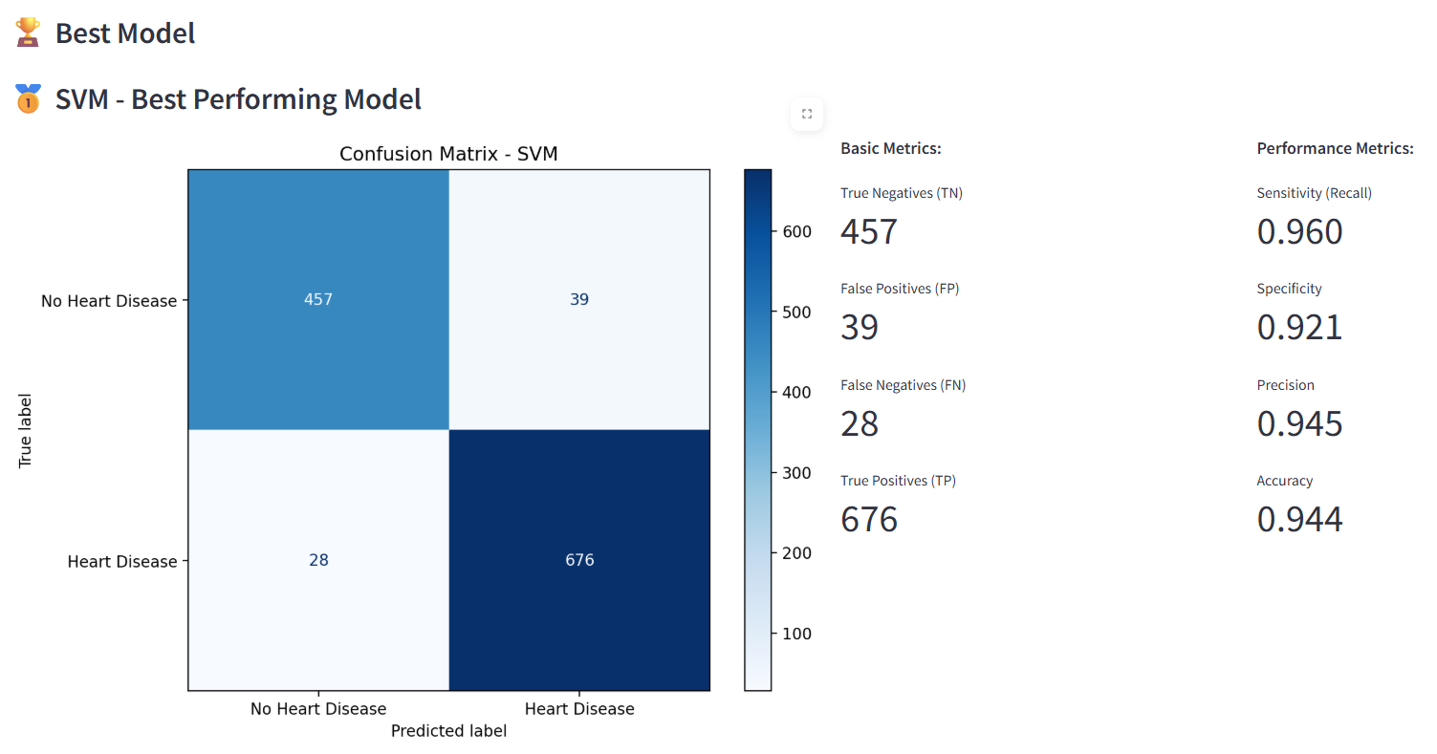
Fig Confusion Matrix of Best Model SVM
SVM demonstrates the highest accuracy and recall, making it the most reliable model for early and accurate heart disease detection in this study.

Slide 17
CONCLUSION
dataset and evaluated using key metrics: accuracy, precision, recall, and F1 sIn this project, a user-friendly Streamlit web application was successfully developed for the prediction of heart disease using machine learning algorithms. Leveraging the power of Python, the system performed data preprocessing, model training, and real-time predictions efficiently.
The implemented models — K-Nearest Neighbors (KNN) and Decision Tree — were trained on a comprehensive healthcare core.
The application enables users, including healthcare professionals, to input patient data and receive instant, reliable predictions. With its interactive interface and visualization capabilities, the tool enhances decision-making and supports early detection and prevention of heart disease.

Slide 18
REFERENCES
A. Patel, R. Sharma, and M. Kumar, “Heart Disease Prediction Using Machine Learning Algorithms: A Comparative Study,” IEEE Access, vol. 10, pp. 98534–98545, 2022, doi: 10.1109/ACCESS.2022.3198571.
S. Verma, N. Gupta, and A. Yadav, “Early Detection of Cardiovascular Diseases Using Decision Tree and KNN,” International Journal of Advanced Computer Science and Applications (IJACSA), vol. 13, no. 2, pp. 65–72, 2022, doi: 10.14569/IJACSA.2022.0130208.
M. Al-Garadi, A. Mohamed, and S. A. Khan, “Machine Learning-Based Prediction Models for Heart Disease Diagnosis,” Computers in Biology and Medicine, vol. 140, pp. 105112, 2022, doi: 10.1016/j.compbiomed.2021.105112.
P. Singh, K. Malhotra, and R. Joshi, “Prediction of Heart Disease Using Streamlit and Ensemble Learning Models,” International Conference on Computational Intelligence and Data Science (ICCIDS), pp. 325–330, 2023.

Slide 19
THANK YOU

